Slide 1

Project Title:
Analyzing Rental Patterns and Film Popularity in the Maven Movies Database Using Excel and SQL
Kaushal Patil
MCA

Slide 2
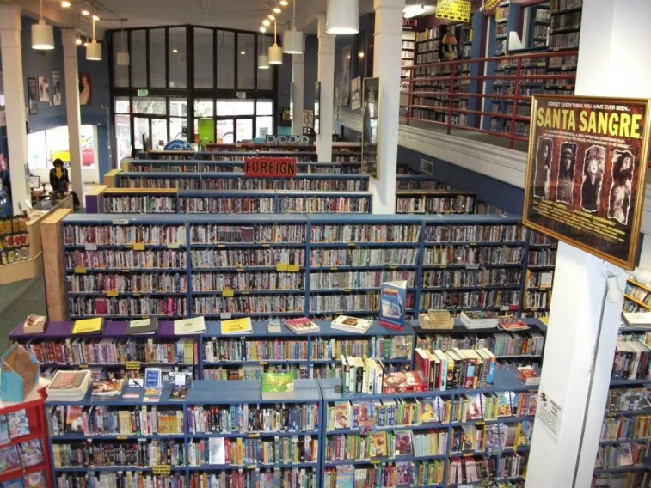
Introduction
Database Overview
The MavenMovies Sakila database serves as a comprehensive repository for film rental information. It contains detailed records on customers, films, rentals, stores, and staff members, offering a rich dataset for analysis.
Data Analysis Methods
Our analysis combines the power of SQL for data retrieval and Excel for visualization and interpretation. SQL queries were designed to extract relevant data on rental trends, film popularity, and store performance. This data was then visualized in Excel to reveal patterns and insights.
Report Objectives
The primary objectives of this report are to: - Identify key trends in rental patterns, including monthly and hourly variations. - Determine the most popular films and categories based on rental volume. - Evaluate the performance of individual stores and staff members in terms of rental revenue and activity.

Slide 3
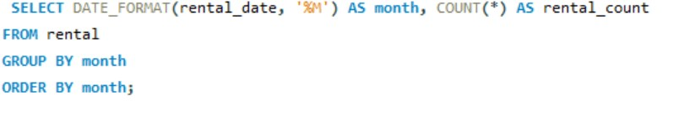
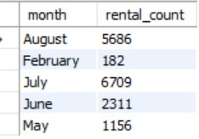
Rental Trend
Task: 1.1 Analyze The Monthly Rental Trends Over The Available Data Period.

Slide 4
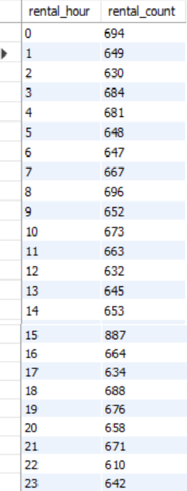
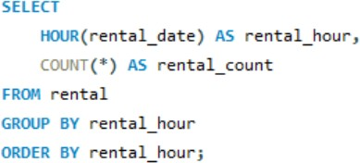
Task:1.2 Determine The Peak Rental Hours In A Day Based On Rental Transactions

Slide 5
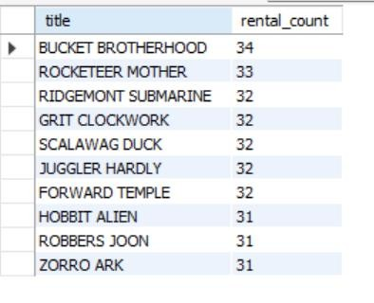
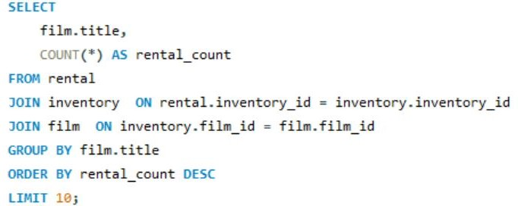
2.Film Popularity
Task-2.1 Identify the top 10 most rented films.

Slide 6
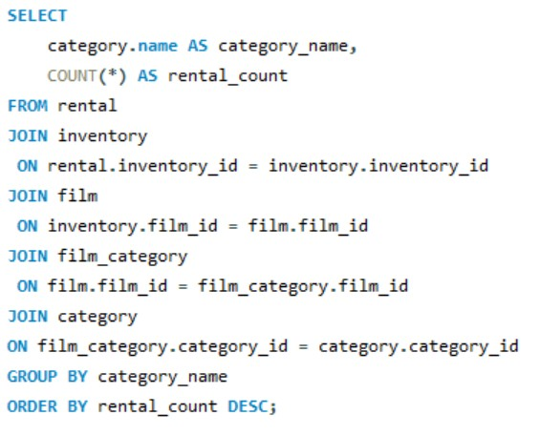
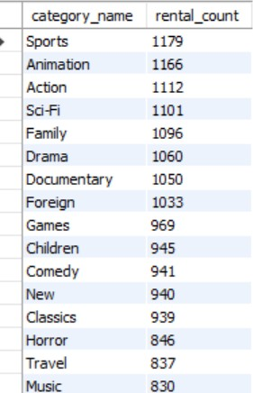
TASK-2.2 Determine which film categories have the highest number of rentals.

Slide 7
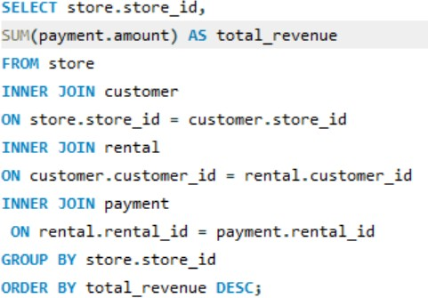

Store Performance
TASK- 3.1 Identify the Store Generating the Highest Rental Revenue

Slide 8
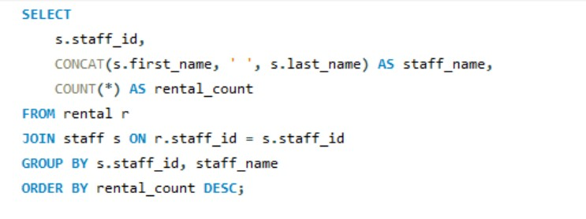
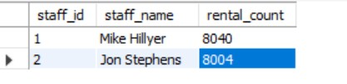
Task-3.2 Determine the distribution of rentals by staff members to assess performance.

Slide 9
To export the results of SQL queries to Excel:
Run your SQL query.
In the query results, click the "Export" button.
Choose the CSV format and save the file to your desired location.
Open Excel and go to "File" > "Open".
Import the data into excel file.
Once the data is imported , select the entire data range.
Go to the “insert” tab and click pivot table , in the pivot field list, drag, drop field to organize your data.
To create visualization , go the “insert“ tab and choose various chart types such as pie, bar, column, line or others.
Customize your charts and organize them to create a dashboard for better visualization

Slide 10
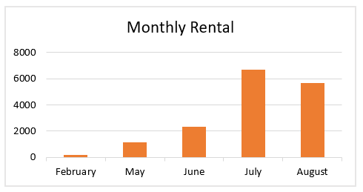
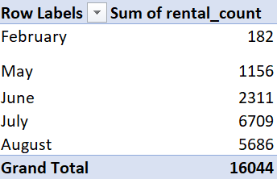
SQL query results to Excel, creating a pivot table, and then generating various visualizations:
Task-1.1 pivot table

Slide 11
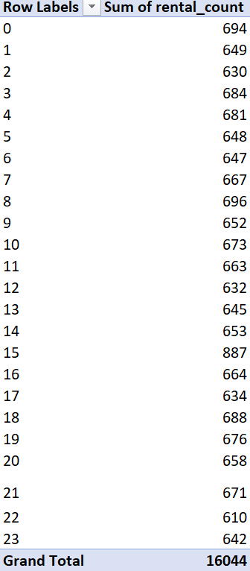
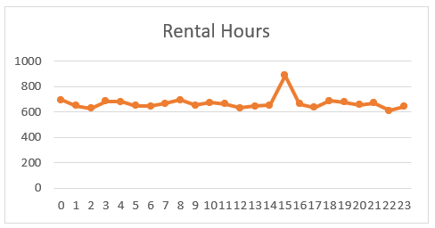
Task:-1.2 pivot table

Slide 12
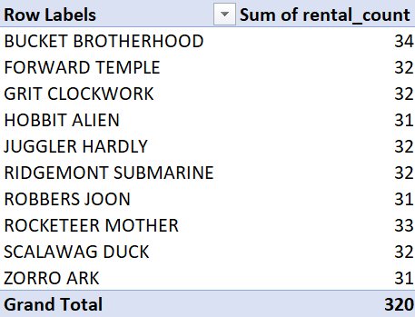
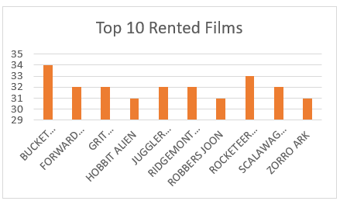
Task-2.1 Pivot Table

Slide 13
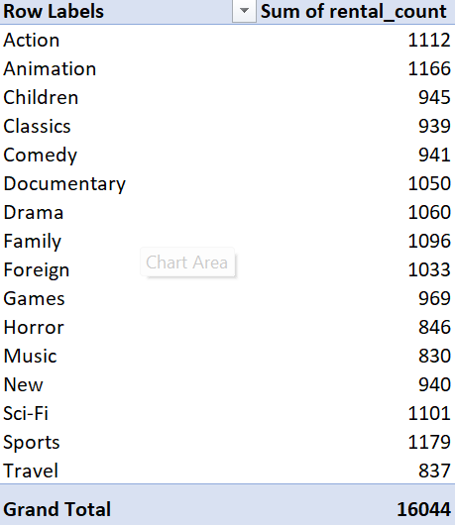
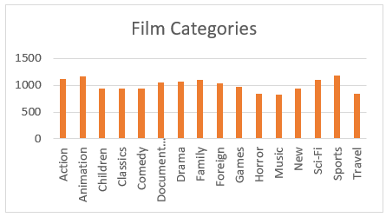
Task-2.2 pivot table

Slide 14
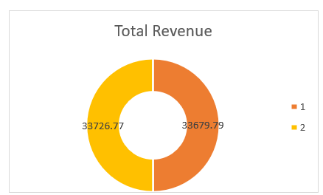
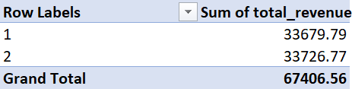
Task-3.1 Pivot Table

Slide 15
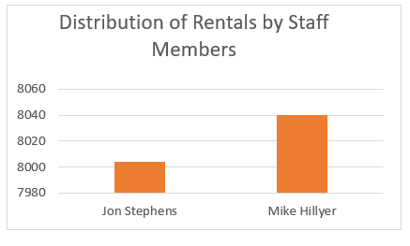
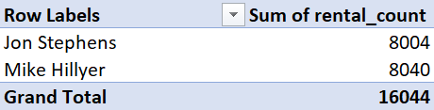
Task-3.2 Pivot Table

Slide 16
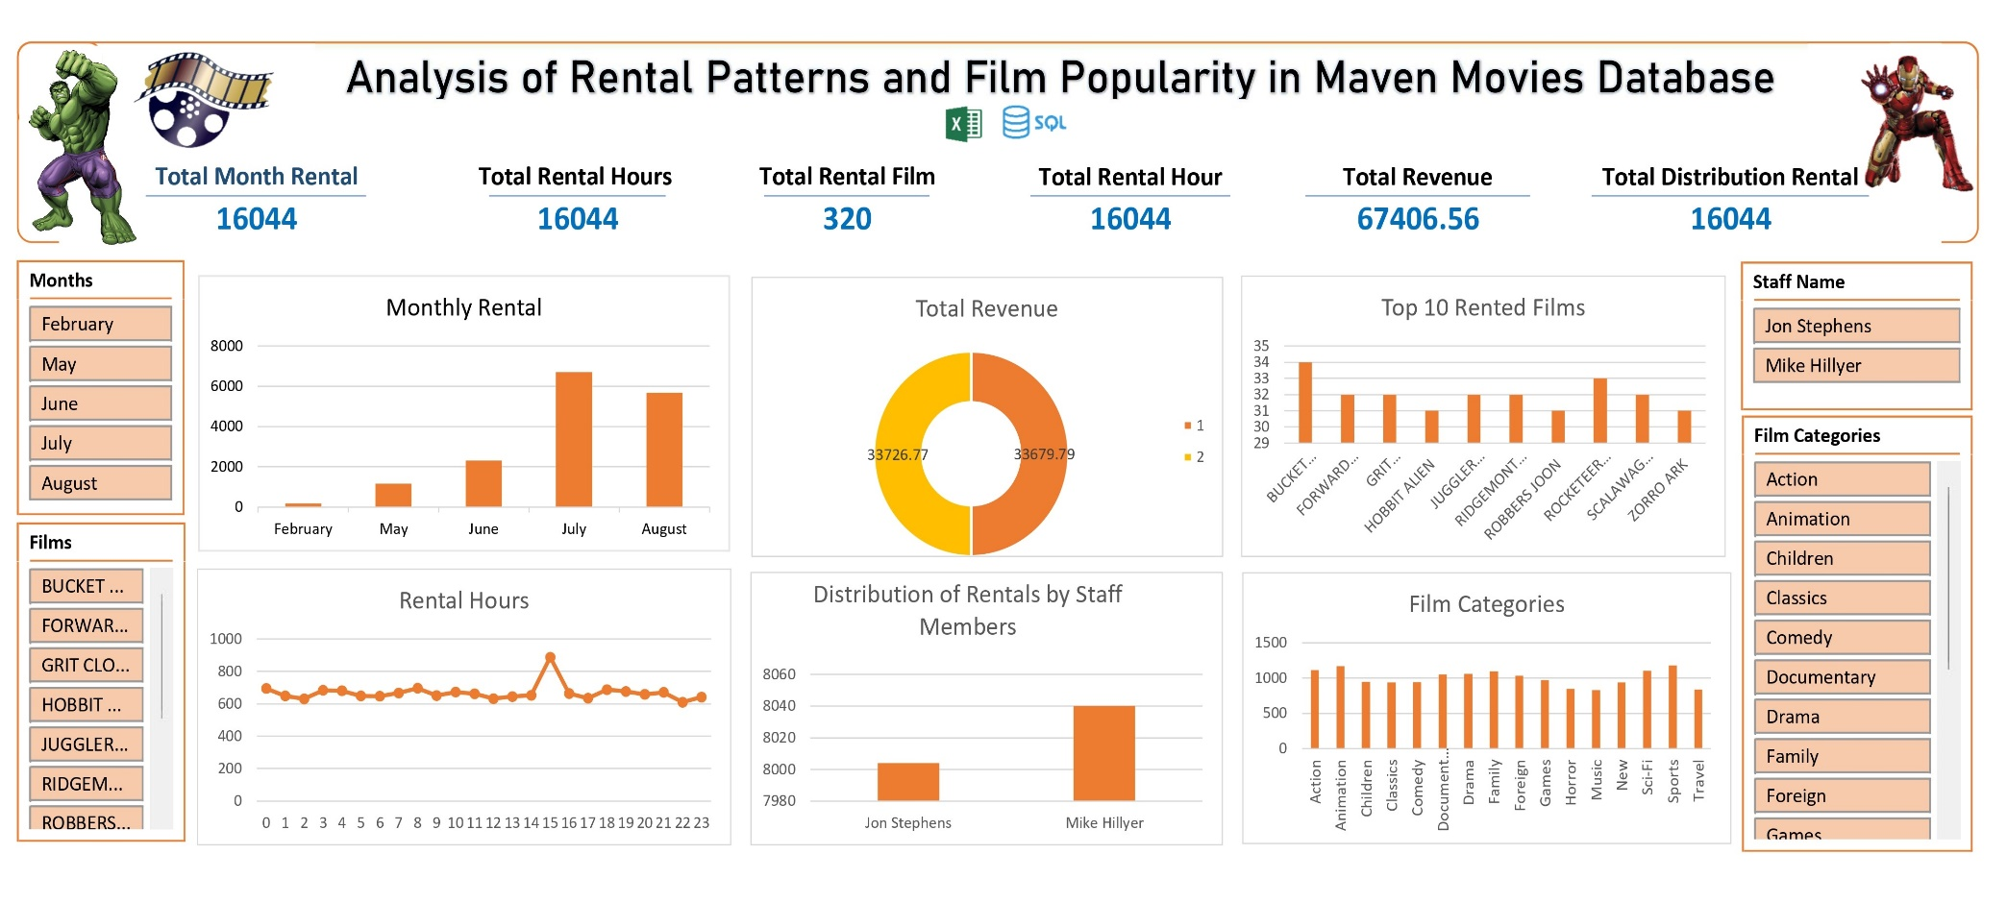
The Final Dashboard Is Ready

Slide 17

Rental Trends
1
Monthly Rental Trends
Analysis of monthly rental data revealed a clear seasonal pattern. The highest rental activity occurs during the summer months, likely due to school breaks and vacation time. Conversely, rentals tend to decline during winter months. This insight suggests opportunities for targeted promotions during peak rental periods.
2
Peak Rental Hours
Rental volume peaks during the evening hours, specifically between 6 PM and 8 PM. This coincides with the time when people are typically returning home from work or school, highlighting a prime opportunity for late-night rentals. This information can be used to optimize store hours and staffing levels during peak rental times.
3
Rental Trends by Day
While rentals are generally highest on weekends, there are significant variations depending on the specific day of the week. Friday and Saturday nights are particularly popular for movie rentals, suggesting that a dedicated marketing strategy focused on weekend entertainment could be beneficial.

Slide 18
Film Popularity
Top 10 Most Rented Films
Popular Film Categories
Film Rating and Popularity
The Lord of the Rings: The Return of the King
Action
Analyzing the correlation between film ratings and rental frequency reveals that highly-rated films tend to have a higher rental volume. This suggests that customer reviews and ratings play a significant role in film selection. In addition, focusing on marketing efforts for highly-rated films could further enhance their popularity and drive more rentals.
Comedy
Star Wars: Episode V - The Empire Strikes Back
Drama
Animation
The Lord of the Rings: The Fellowship of the Ring
Sci-Fi
Action, comedy, and drama categories consistently rank among the most rented. This data suggests that these genres are consistently popular with customers. However, the relatively low rental volume for categories such as documentary and foreign films might indicate a niche market.
Pirates of the Caribbean: The Curse of the Black Pearl
Finding Nemo
Shrek
The Lord of the Rings: The Two Towers
The Matrix
Kill Bill: Vol. 1
Spirited Away
The most popular films are a mix of action, fantasy, and animated genres, reflecting diverse customer tastes. These films consistently attract high rental volume, suggesting a strong demand for these genres.

Slide 19



Store Performance
Store Revenue Comparison
Inventory Analysis
Staff Performance
Store 1 consistently generates significantly higher rental revenue than Store 2. This difference could be attributed to several factors, including location, customer base, inventory management, and staffing effectiveness.
Comparing inventory levels across both stores reveals that Store 1 maintains a broader selection of popular films, while Store 2's inventory is more limited. This suggests that Store 1's comprehensive selection could be a contributing factor to its higher revenue generation.
While Store 1 consistently generates higher revenue, a closer examination of individual staff members reveals significant variations in performance. Some staff members consistently handle a higher number of rentals, indicating potential differences in customer service skills and interactions. This insight suggests the need for training and development programs to enhance staff effectiveness and customer satisfaction.

Slide 20

Conclusion and Recommendations
1
Key Findings
The analysis has revealed valuable insights into rental patterns, film preferences, and store performance: - Seasonal Rental Trends: Summer months exhibit higher rental activity, suggesting the need for targeted promotions during these periods. - Peak Rental Hours: Evening hours see a significant increase in rentals, prompting consideration of extended store hours and optimized staffing during these times. - Popular Films and Categories: Action, comedy, and drama consistently attract high rental volume, highlighting the importance of maintaining a well-stocked inventory in these genres. - Store and Staff Performance: Store 1's higher revenue generation suggests its strategic location and potentially better inventory management and staffing practices.
2
Recommendations
- Implement targeted promotions during peak rental months to capitalize on increased customer activity. - Consider adjusting store hours to stay open later during peak rental times. - Ensure that popular genres are well-stocked to meet customer demand. - Develop training programs for staff to ensure consistent and high-quality customer service across all stores. - Conduct a comprehensive review of Store 1's operations to understand its success factors and potentially implement similar strategies in Store 2. - Monitor staff performance and provide targeted training to improve customer service skills and overall efficiency.

Slide 21


